Slide 1
Clustering metrics

Slide 2
Clustering metrics
Clustering metrics are quantitative measures used to evaluate the quality of clustering algorithms and the resulting clusters.
Internal Evaluation Metrics: These metrics evaluate the quality of clusters without any external reference. They measure the compactness of data points within the same cluster and the separation between different clusters.
Such as: Silhouette Score, Davies-Bouldin Index, Calinski-Harabasz Index (Variance Ratio Criterion), Dunn Index
External Evaluation Metrics: These metrics require a ground truth or a reference set of labels to compare the clustering results against. They measure the agreement between the generated clusters and the true classes in the reference set.
Such as: Adjusted Rand Index (ARI), Normalized Mutual Information (NMI), Fowlkes-Mallows Index

Slide 3
Silhouette Score
Silhouette Coefficient or silhouette score is a metric used to calculate the goodness of a clustering technique. This score is calculated by measuring each data point’s similarity to the cluster it belongs to and how different it is from other clusters. The Silhouette score is commonly used to assess the performance of clustering algorithms like K-Means.
Its value ranges from -1 to 1.
1: Means clusters are well apart from each other and clearly distinguished (Best Case)
0: Means clusters are indifferent, or we can say that the distance between clusters is not significant (Overlapping Clusters)
-1: Means clusters are assigned in the wrong way (Worst Case)

Slide 4
It is computed as:
The silhouette value is a measure of how similar an object is to its own cluster (cohesion) compared to other clusters (separation).
Silhouette Score = (b-a)/max(a,b)
where
a= average intra-cluster distance i.e the average distance between each point within a cluster
b= average inter-cluster distance i.e the average distance between all clusters

Slide 5
Example:
Datapoints | Cluster Label
A1 | C1
A2 | C1
A3 | C2
A4 | C2
Datapoint | A1 | A2 | A3 | A4
A1 | 0 | 0.10 | 0.65 | 0.55
A2 | 0.10 | 0 | 0.70 | 0.60
A3 | 0.65 | 0.70 | 0 | 0.30
A4 | 0.55 | 0.60 | 0.30 | 0

Slide 6
For point A1: a= 0.1/1=0.1 b= (0.65+0.55)/2=0.6 Silhouette Score = (b-a)/max(a,b)
(0.6-0.1)/ 0.6= 0.833
For point A2: a= 0.1/1=0.1 b= (0.70+0.60)/2=0.65 Silhouette Score = (b-a)/max(a,b)
(0.65-0.1)/ 0.65= 0.846
For point A3: a= 0.30/1=0.30 b= (0.65+0.70)/2=0.675 Silhouette Score = (b-a)/max(a,b)
(0.675-0.30)/ 0.675= 0.555
For point A4: a= 0.30/1=0.30 b= (0.55+0.60)/2=0.575 Silhouette Score = (b-a)/max(a,b)
(0.575-0.30)/ 0.575= 0.478

Slide 7
Point A1 and A2 are lying cluster C1 , so for computing Silhouette Score for cluster C1,
(0.833+0.846)/2= 1.679/2= 0.839
Point A3 and A4 are lying cluster C2 , so for computing Silhouette Score for cluster C2,
(0.555+0.478)/2= 1.033/2= 0.5165
Silhouette Score/Coefficient for overall clustering problem is:
(0.839+0.5165)/2= 0.6775 or 0.678

Slide 8
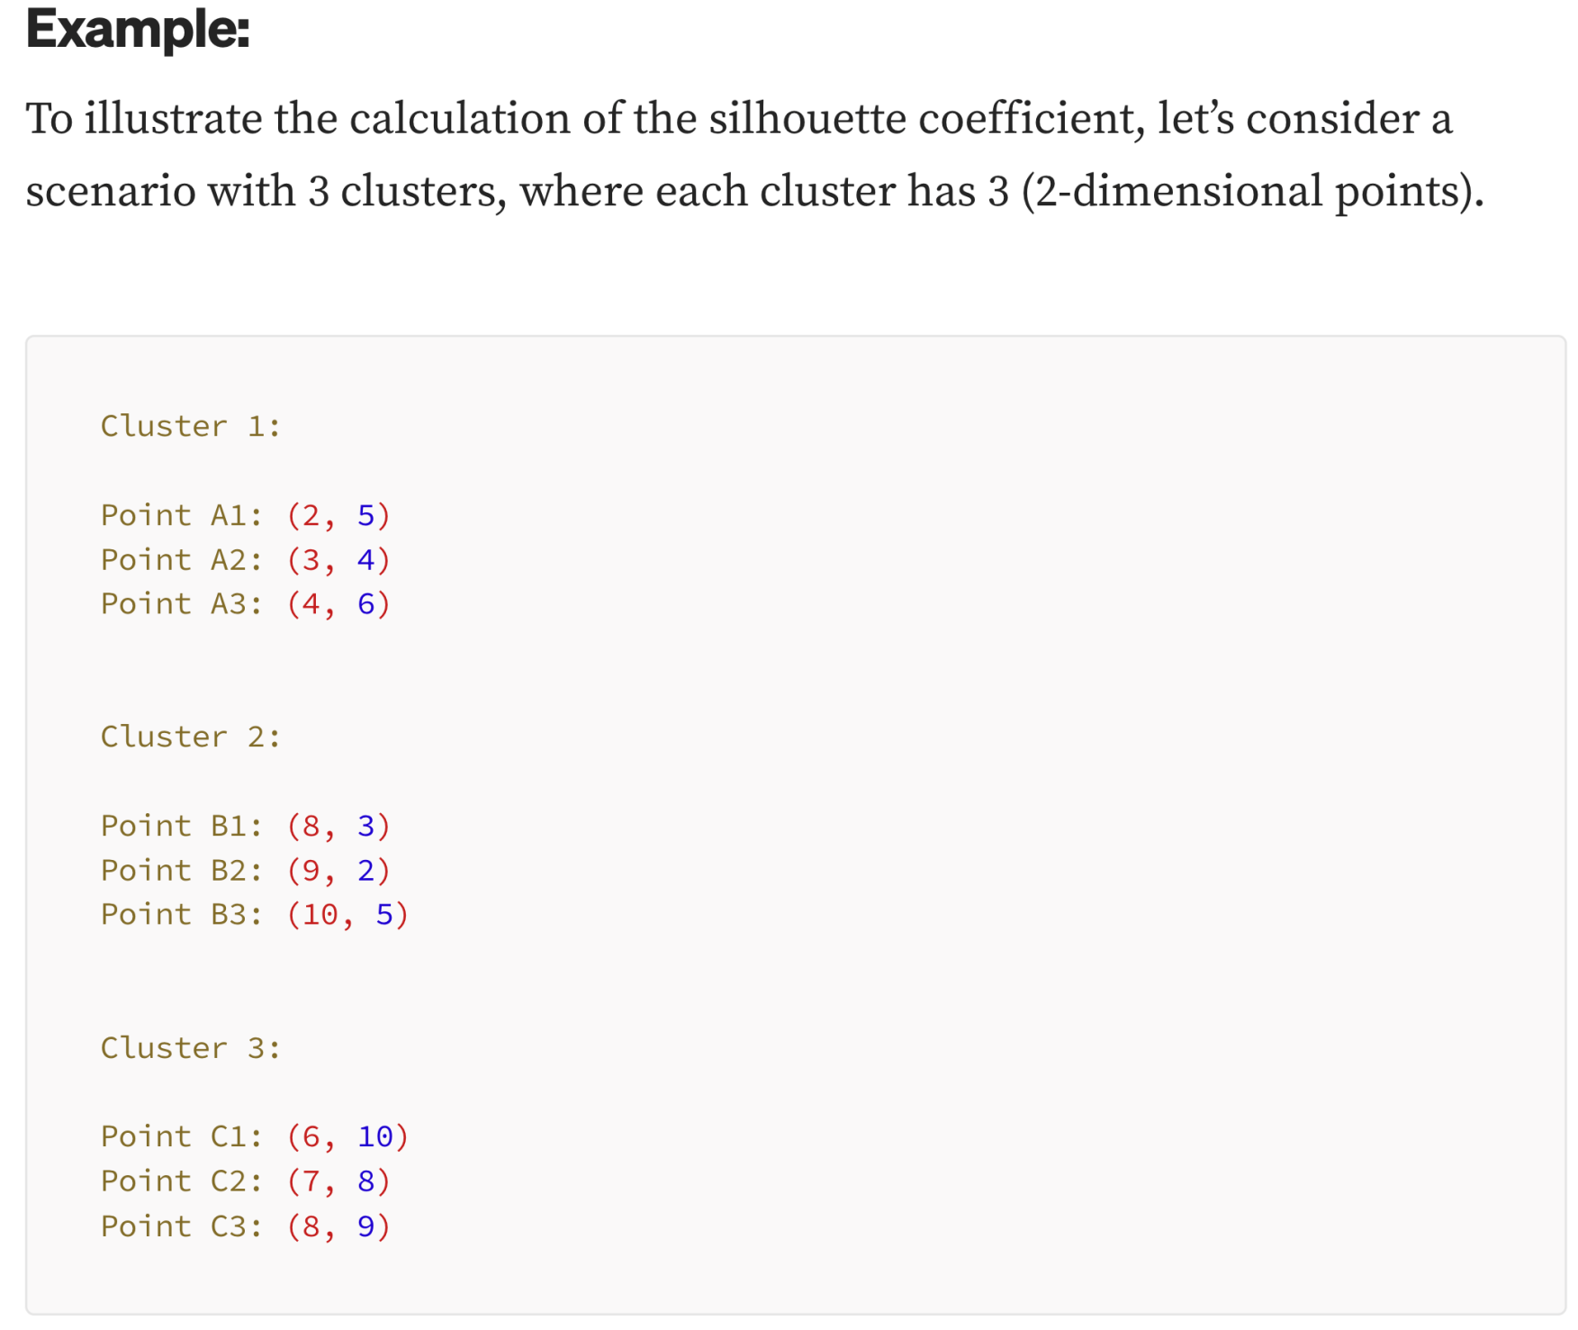

Slide 9
Davies-Bouldin Index
The Davies-Bouldin index (DBI) is a metric for assessing the separation and compactness of clusters.
It is based on the idea that good clusters are those that have low within-cluster variation and high between-cluster separation.
The minimum score is zero, with lower values indicating better clustering.
Lower the DB index value, better is the clustering.

Slide 10


Where,

Slide 11
Example
Data Point 1: (2, 3)
Data Point 2: (3, 2)
Data Point 3: (8, 8)
Data Point 4: (9, 7)
Data Point 5: (15, 14)
Data Point 6: (16, 13)

Slide 12
Let's say we want to perform K-means clustering on this dataset with K = 2. After clustering, the data points are divided into two clusters:
Cluster 1: {Data Point 1, Data Point 2} Cluster 2: {Data Point 3, Data Point 4, Data Point 5, Data Point 6}
The centroids of these clusters are approximately:
Centroid of Cluster 1: (2.5, 2.5) Centroid of Cluster 2: (12, 10.5)
Now, let's calculate the pairwise distances between the centroids of each cluster:

Slide 13
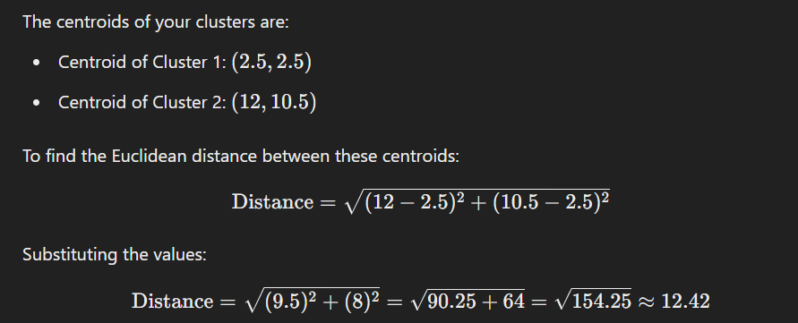
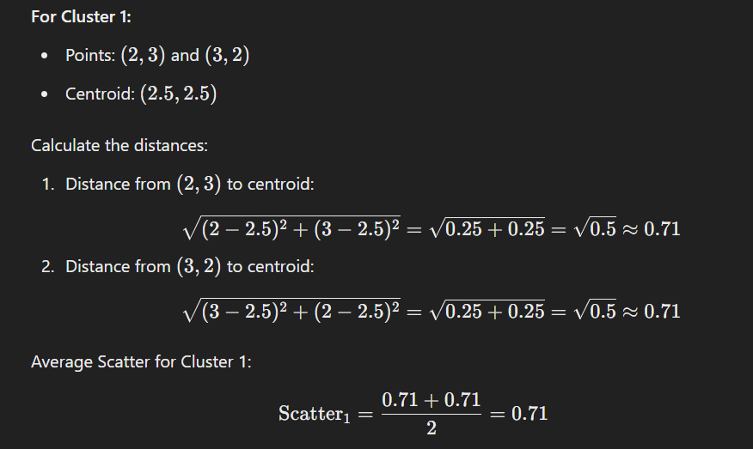
Now, let's calculate the pairwise distances between the centroids of each cluster:

Slide 14
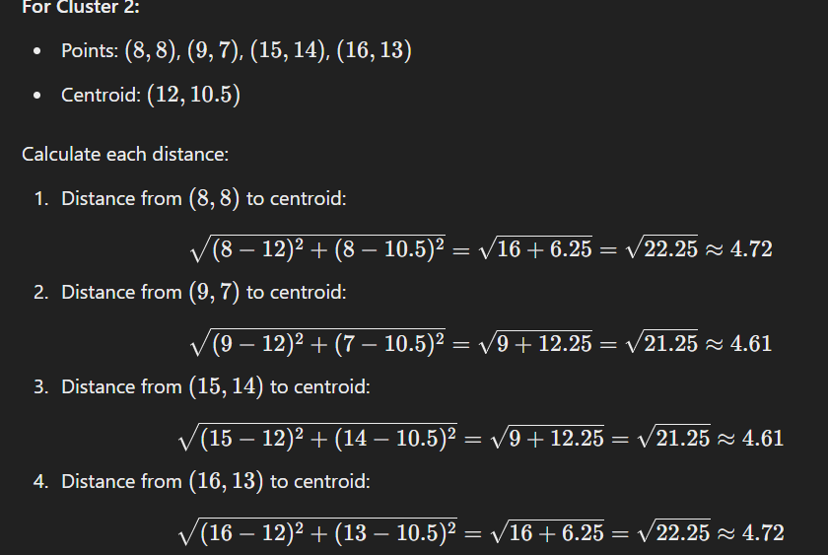

Slide 15
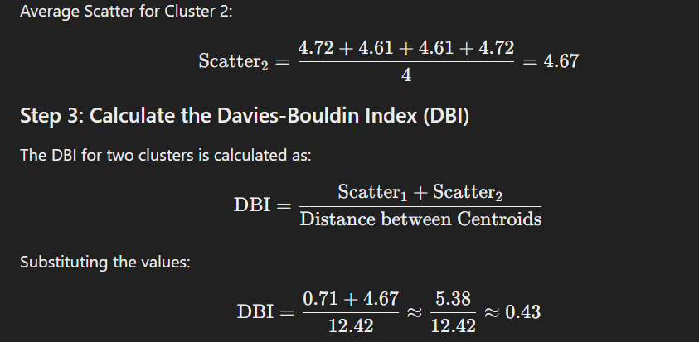

Slide 16
from sklearn.datasets import make_blobs
from sklearn.cluster import KMeans
from sklearn.metrics import silhouette_score
import matplotlib.pyplot as plt
import numpy as np
from sklearn.metrics import davies_bouldin_score
data1 = np.array([[6, 8], [9, 5], [5, 4], [2, 6], [5,6], [3,4]])
labels1 = np.array([0, 0, 1, 1, 1, 0])
davies_bouldin_index = davies_bouldin_score(data1, labels1)
print("Davies-Bouldin Index:", davies_bouldin_index)

Slide 17
Dunn index:
A metric for evaluating clustering algorithms, is an internal evaluation scheme, where the result is based on the clustered data itself.
Like all other such indices, the aim of this Dunn index to identify sets of clusters that are compact, with a small variance between members of the cluster, and well separated, where the means of different clusters are sufficiently far apart, as compared to the within cluster variance.
Higher the Dunn index value, better is the clustering.
The number of clusters that maximizes Dunn index is taken as the optimal number of clusters k.

Slide 18

Where,

Slide 19
A higher Dunn Index value indicates better clustering, as it implies that the clusters are compact and well-separated. Let's go through a numerical example to illustrate the concept.
Consider a dataset with 8 data points in a 2D space:
Data Point 1: (2, 3) Data Point 2: (3, 2) Data Point 3: (4, 3) Data Point 4: (8, 8) Data Point 5: (9, 7) Data Point 6: (10, 8) Data Point 7: (15, 14) Data Point 8: (16, 13)

Slide 20
Let's say we want to perform K-means clustering on this dataset with K = 2. After clustering, the data points are divided into two clusters:
Cluster 1: {Data Point 1, Data Point 2, Data Point 3} Cluster 2: {Data Point 4, Data Point 5, Data Point 6, Data Point 7, Data Point 8}
Now, let's calculate the inter-cluster distances (minimum distance between any two points from different clusters) and intra-cluster distances (maximum distance between any two points within the same cluster):

Slide 21
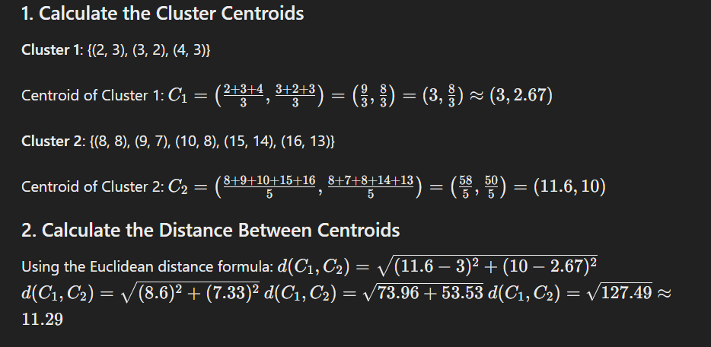

Slide 22
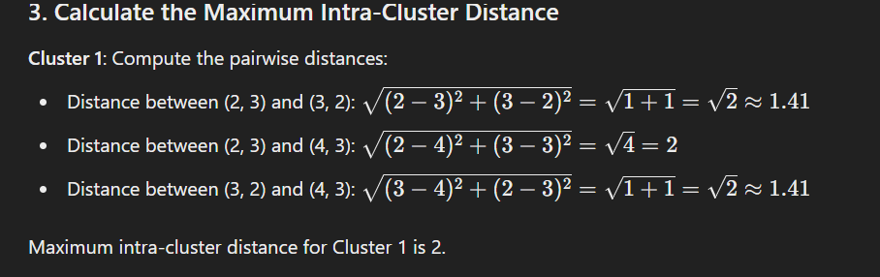

Slide 23
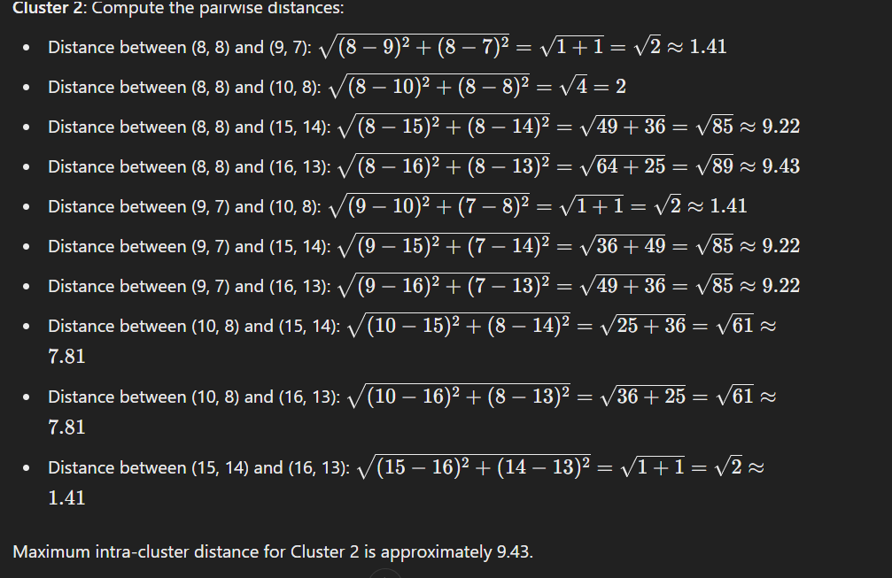

Slide 24
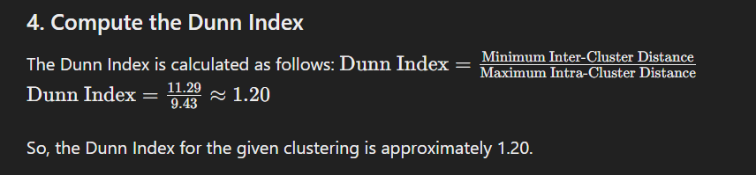

Slide 25
Example
Let's work through a numerical example to calculate the Dunn Index for a simple set of clusters. Suppose you have the following data points and their corresponding clusters:
Data Points:
A(1, 2)
B(2, 2)
C(5, 8)
D(6, 8)
E(10, 12)
F(11, 12)
Clusters:
Cluster 1: {A, B}
Cluster 2: {C, D}
Cluster 3: {E, F}

Slide 26
Distance between Cluster 1 and Cluster 2 (d(1, 2)):
d(A, C) = sqrt((1-5)^2 + (2-8)^2) = sqrt(32) = 4√2
d(A, D) = sqrt((1-6)^2 + (2-8)^2) = sqrt(41) ≈ 6.40
d(B, C) = sqrt((2-5)^2 + (2-8)^2) = sqrt(29) ≈ 5.39
d(B, D) = sqrt((2-6)^2 + (2-8)^2) = sqrt(36) = 6
So, d(1, 2) = 4√2
Distance between Cluster 1 and Cluster 3 (d(1, 3)):
d(A, E) = sqrt((1-10)^2 + (2-12)^2) = sqrt(170) ≈ 13.04
d(A, F) = sqrt((1-11)^2 + (2-12)^2) = sqrt(200) ≈ 14.14
d(B, E) = sqrt((2-10)^2 + (2-12)^2) = sqrt(164) ≈ 12.81
d(B, F) = sqrt((2-11)^2 + (2-12)^2) = sqrt(194) ≈ 13.93
So, d(1, 3) = 12.81
Distance between Cluster 2 and Cluster 3 (d(2, 3)):
d(C, E) = sqrt((5-10)^2 + (8-12)^2) = sqrt(20) ≈ 4.47
d(C, F) = sqrt((5-11)^2 + (8-12)^2) = sqrt(32) ≈ 5.66
d(D, E) = sqrt((6-10)^2 + (8-12)^2) = sqrt(16) = 4
d(D, F) = sqrt((6-11)^2 + (8-12)^2) = sqrt(29) ≈ 5.39
So, d(2, 3) = 4.47

Slide 27
Now, let's calculate the minimum inter-cluster distance and the maximum intra-cluster distance:
Minimum Inter-cluster Distance: min(d(1, 2), d(1, 3), d(2, 3)) = min(4√2, 12.81, 4.47) = 4√2
Maximum Intra-cluster Distance: max(max(d(A, B), d(C, D), d(E, F))) = max(6.40, 6.40, 14.14) = 14.14

Slide 28
Finally, we can calculate the Dunn Index:
Dunn Index = min(d(1, 2), d(1, 3), d(2, 3)) / max(max(d(A, B), d(C, D), d(E, F))) Dunn Index = (4√2) / 14.14 ≈ 0.2828
So, the Dunn Index for these clusters is approximately 0.2828.

Slide 29
Data Point | Coordinates | Cluster
1 | (2, 3) | A
2 | (2, 5) | A
3 | (3, 8) | B
4 | (6, 5) | B
5 | (8, 8) | C
6 | (9, 6) | C
7 | (10, 2) | A
8 | (12, 4) | A
9 | (15, 7) | C
10 | (17, 5) | C

Slide 30
Drawbacks of Dunn index:
As the number of clusters and dimensionality of the data increase, the computational cost also increases.

Slide 31
Adjusted Rand Index (ARI)
It measures the similarity between the true class labels and the clusters generated by a clustering algorithm while accounting for chance agreement.
The ARI produces a score between -1 and 1, where higher values indicate better agreement between the predicted clusters and the true labels.
Contigency table- m x n
m= number of clusters by c1 algo.
n= number of clusters by c2 algo (Ground Truth)

Slide 32
To use the Adjusted Rand Index for evaluating clustering, follow these steps:
Perform Clustering: Apply a clustering algorithm to your dataset to create clusters of data points. This could be an algorithm like k-means, hierarchical clustering, DBSCAN, or any other clustering technique.
Obtain True Class Labels: If you have access to ground truth labels or class assignments for your data, this is ideal. These true labels represent the actual groups or categories that your data points belong to.

Slide 33
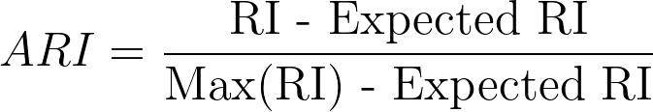

Slide 34
Example
Suppose you have two clustering results for a dataset with 100 data points:
Create a contingency table that shows the number of data points in common between the two clusterings. Rows represent clusters in Clustering A, and columns represent clusters in Clustering B. The table might look like this:
| Cluster 1 | Cluster 2 |
-----------------------------------
Cluster 1 | 30 | 20 |
-----------------------------------
Cluster 2 | 40 | 10 |
-----------------------------------

Slide 35
Calculate the sum of squares for the rows and columns of the contingency table. Let's denote these as SSR (Sum of Squares for Rows) and SSC (Sum of Squares for Columns):
SSR = (30^2 + 20^2) + (40^2 + 10^2) = (900 + 400)+(1600+100) = 3000
SSC = (30^2 + 40^2) + (20^2 + 10^2) = 2500 + 500 = 3000
Now Calculate ARI = [ (RI - Expected_RI) ] / [ max(RI) - Expected_RI ) ]

Slide 36
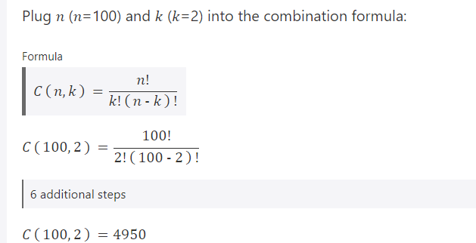
The Rand Index (RI) is calculated as (SSR + SSC) / [2 * (N choose 2)], where N is the total number of data points (100 in this case).
Choose (100,2)
There are 4,950 ways that 2 items chosen from a set of 100 can be combined.
RI = (3000 + 3000) / [2 * (100 choose 2)] = 6000 / [2 * 4950] ≈ 0.606
Expected_RI = (SSR * SSC) / [2 * (N choose 2)^2] = (3000 * 3000) / [2 * 4950^2] ≈ 0.183
ARI = [ (0.606 - 0.183) ] / [ 1 - 0.183 ] ≈ 0.517
So, the Adjusted Rand Index (ARI) for the given clustering A and B is approximately 0.51. This indicates a moderate agreement between the two clusterings, where a higher ARI value would indicate better agreement.

Slide 37
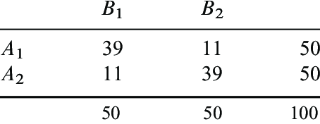
Compute Adjusted rand Index

Slide 38
Normalized Mutual Information (NMI)
Normalized Mutual Information (NMI) is a normalization of the Mutual Information (MI) score to scale the results between 0 (no mutual information) and 1 (perfect correlation).

Slide 39
NMI
NMI is a good measure for determining the quality of clustering.
It is an external measure because we need the class labels of the instances to determine the NMI.
Since it’s normalized we can measure and compare the NMI between different clusterings having different number of clusters.

Slide 40
Normalized Mutual Information
Normalized Mutual Information:
2 × 𝐼(𝑌; 𝐶)
𝑁𝑀𝐼 𝑌, 𝐶 =
𝐻 𝑌 + 𝐻 𝐶
where,
Y = class labels
C = cluster labels
H(.) = Entropy
4) I(Y;C) = Mutual Information b/w Y and C Note: All logs are base-2.

Slide 41


Calculating NMI for Clustering
Assume m=3 classes and k=2 clusters
Cluster-1 (C=1)
Cluster-2 (C=2)
Class-1 (Y=1)
Class-2 (Y=2)
Class-3 (Y=3)

Slide 42
H(Y) = Entropy of Class Labels
P(Y=1) = 5/20 = ¼
P(Y=2) = 10/20 = ½
P(Y=3) = 5/20 =¼
1
4
1
4
1
2
H(Y) = − ¹ log
− ¹ log
− ¹ log
= 1.5
4
4
2
This is calculated for the entire dataset and can be calculated prior to clustering, as it will not change depending on the clustering output.

Slide 43
H(C) = Entropy of Cluster Labels
P(C=1) = 10/20 = 1/2
P(C=2) = 10/20 = ½
1
2
H(Y) =− ¹ log
¹ − ¹ log
2 2
= 1
2
This will be calculated every time the clustering changes. You can see from the figure that the clusters are balanced (have equal number of instances).

Slide 44
I(Y;C)= Mutual Information
Mutual information is given as:
– 𝐼 𝑌; 𝐶 = 𝐻 𝑌 − 𝐻 𝑌 𝐶
We already know H(Y)
H(Y|C) is the entropy of class labels within each cluster, how do we calculate this??
Mutual Information tells us the reduction in the entropy of class labels that we get if we know the cluster labels. (Similar to Information gain in deicison trees)

Slide 45
H(Y|C): conditional entropy of class labels for clustering C
Consider Cluster-1:
P(Y=1|C=1)=3/10 (three triangles in cluster-1)
P(Y=2|C=1)=3/10 (three rectangles in cluster-1)
P(Y=3|C=1)=4/10 (four stars in cluster-1)
Calculate conditional entropy as:
𝐻 𝑌 𝐶 = 1
= −𝑃(𝐶 = 1)
∑
Y∈ {1,2,3}
𝑃 𝑌 = 𝑦 𝐶 = 1 log(𝑃 𝑌 = 𝑦 𝐶 = 1 )
1 3
3
10
3
3 4
4
=− ₂ × [ log
+ log( )+ log( )] = 0.7855
10
10
10 10
10

Slide 46
H(Y|C): conditional entropy of class labels for clustering C
Now, consider Cluster-2:
P(Y=1|C=2)=2/10 (two triangles in cluster-2)
P(Y=2|C=2)=7/10 (seven rectangles in cluster-2)
P(Y=3|C=2)=1/10 (one star in cluster-2)
Calculate conditional entropy as:
𝐻 𝑌 𝐶 = 2
= −𝑃(𝐶 = 2)
∑
Y∈ {1,2,3}
𝑃 𝑌 = 𝑦 𝐶 = 2 log(𝑃 𝑌 = 𝑦 𝐶 = 2 )
1 2
2
10
7
7 1
1
=− ₂ × [ log
+ log( )+ log( )] = 0.5784
10
10
10 10
10

Slide 47
I(Y;C)
Finally the mutual information is:
𝐼 𝑌; 𝐶
= 𝐻 𝑌 − 𝐻 𝑌 𝐶
= 1.5 − 0.7855 + 0.5784
= 0.1361
The NMI is therefore,
𝑁𝑀𝐼 𝑌, 𝐶 =
2 × 𝐼(𝑌; 𝐶)
𝐻 𝑌 + 𝐻 𝐶
₌ 2 × 0.1361 _{= 0.1089}
𝑁𝑀𝐼 𝑌, 𝐶
1.5 + 1

Slide 48
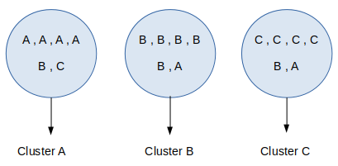
Calculate NMI for the following

Slide 49
Homogeneity
A clustering result satisfies homogeneity if all of its clusters contain only data points which are members of a single class.
This metric is independent of the absolute values of the labels: a permutation of the class or cluster label values won’t change the score value in any way.
Syntax : sklearn.metrics.homogeneity_score(labels_true, labels_pred)
The Metric is not symmetric, switching label_true with label_pred will return the completeness_score.

Slide 50
Parameters :
labels_true:<int array, shape = [n_samples]> : It accept the ground truth class labels to be used as a reference.
labels_pred: <array-like of shape (n_samples,)>: It accepts the cluster labels to evaluate.
Returns:
homogeneity:<float>: Its return the score between 0.0 and 1.0 stands for perfectly homogeneous labeling.

Slide 51
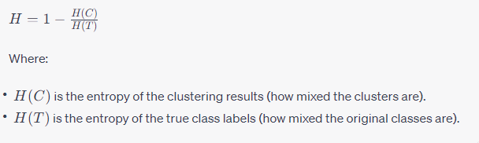
To calculate homogeneity numerically, you can use the following formula:

Slide 52
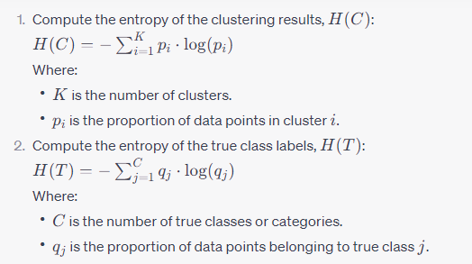

Slide 53
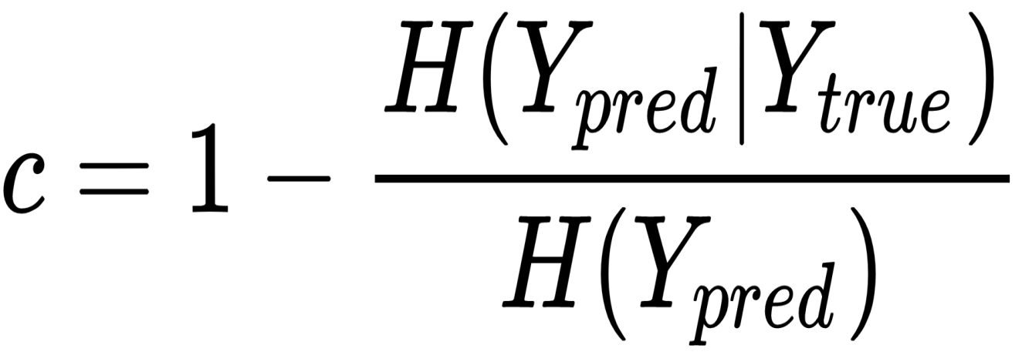
Completeness score
This score is complementary to the previous one. Its purpose is to provide a piece of information about the assignment of samples belonging to the same class.
More precisely, a good clustering algorithm should assign all samples with the same true label to the same cluster.

Slide 54
Completeness portrays the closeness of the clustering algorithm to this (completeness_score) perfection.
This metric is autonomous of the outright values of the labels. A permutation of the cluster label values won’t change the score value in any way.
sklearn.metrics.completeness_score()
Syntax: sklearn.metrics.completeness_score(labels_true, labels_pred)
labels_true:<int array, shape = [n_samples]>: It accepts the ground truth class labels to be used as a reference.
labels_pred: <array-like of shape (n_samples,)>: It accepts the cluster labels to evaluate.
Returns: completeness score between 0.0 and 1.0. 1.0 stands for perfectly completeness labeling.

Slide 55
V-Measure
One of the primary disadvantages of any clustering technique is that it is difficult to evaluate its performance. To tackle this problem, the metric of V-Measure was developed. The calculation of the V-Measure first requires the calculation of two terms:-
Homogeneity: A perfectly homogeneous clustering is one where each cluster has data-points belonging to the same class label. Homogeneity describes the closeness of the clustering algorithm to this perfection.
Completeness: A perfectly complete clustering is one where all data-points belonging to the same class are clustered into the same cluster. Completeness describes the closeness of the clustering algorithm to this perfection.
sklearn.metrics.v_measure_score(labels_true, labels_pred, *, beta=1.0)
The V-measure is the harmonic mean between homogeneity and completeness:
v = (1 + beta) * homogeneity * completeness
/ (beta * homogeneity + completeness)

Slide 56
Fowlkes-Mallows Score
The Fowlkes-Mallows Score is an evaluation metric to evaluate the similarity among clustering's obtained after applying different clustering algorithms.
Although technically it is used to quantify the similarity between two clustering's, it is typically used to evaluate the clustering performance of a clustering algorithm by assuming the second clustering to be the ground-truth i.e. the observed data and assuming it to be the perfect clustering.

Slide 57

The Fowlkes-Mallows index (FMI) is defined as the geometric mean between of the precision and recall:
FMI = TP / sqrt((TP + FP) * (TP + FN))
Where TP is the number of True Positive (i.e. the number of pair of points that belongs in the same clusters in both labels_true and labels_pred),
FP is the number of False Positive (i.e. the number of pair of points that belongs in the same clusters in labels_true and not in labels_pred)
and FN is the number of False Negative (i.e the number of pair of points that belongs in the same clusters in labels_pred and not in labels_True).
The score ranges from 0 to 1. A high value indicates a good similarity between two clusters.

Slide 58
Adjusted Mutual Information (AMI)
Adjusted Mutual Information (AMI) is an adjustment of the Mutual Information (MI) score to account for chance.
It accounts for the fact that the MI is generally higher for two clusterings with a larger number of clusters, regardless of whether there is actually more information shared.
For two clusterings U and V, the AMI is given as:
AMI(U, V) = [MI(U, V) - E(MI(U, V))] / [avg(H(U), H(V)) - E(MI(U, V))]

Slide 59
Thank you!

